Slide 1



Community Meeting # 1 – April 11th, 2017
John Sighamony, VTA Project Manager
Adam Dankberg, Kimley-Horn and Associates
Eileen Goodwin, Apex Strategies

Slide 2
Agenda
Presentation
  Project Background
  Existing Conditions
  Project Alternatives Examples
  Next Steps
Q&A
Input Activity

Slide 3
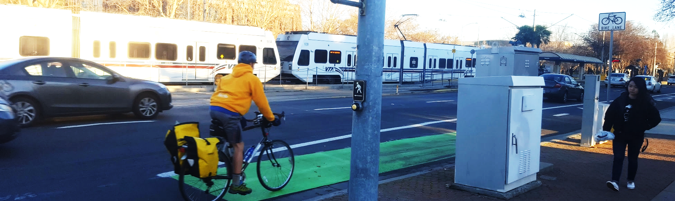
Project Objectives
Enhance the safety, comfort, and reliability of sustainable transportation modes, while still accommodating drivers
Community-supported
Implementable

Slide 4
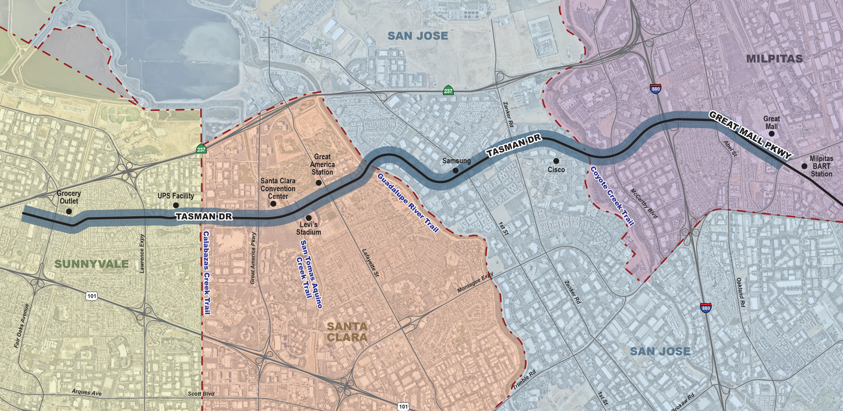
Study Area

Slide 5
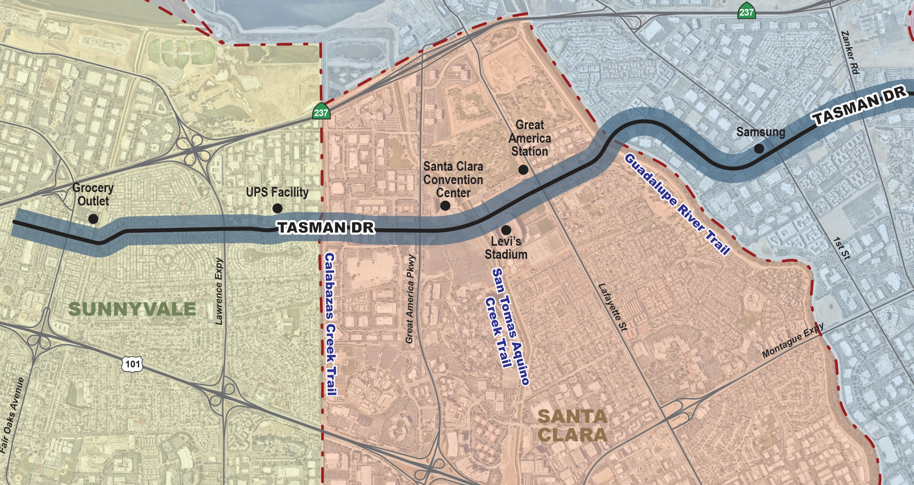
Santa Clara

Slide 6
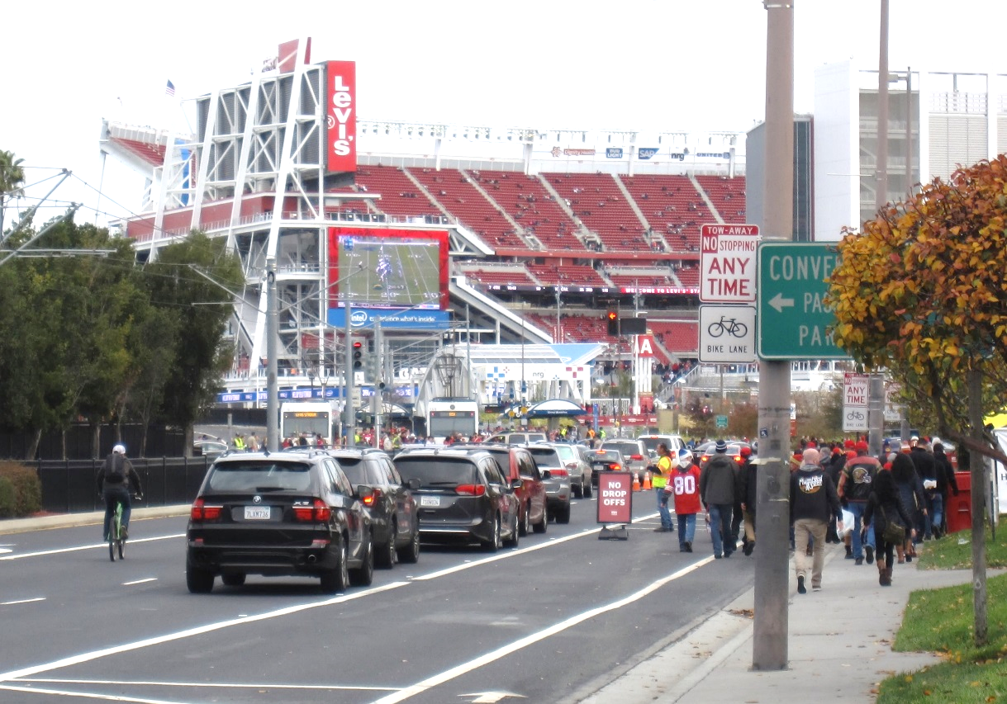
Levi’s Stadium Events
Study considering pedestrian and bicycle circulation around stadium
Traffic circulation and parking not addressed by this study, but covered by Transportation Management Plan

Slide 7
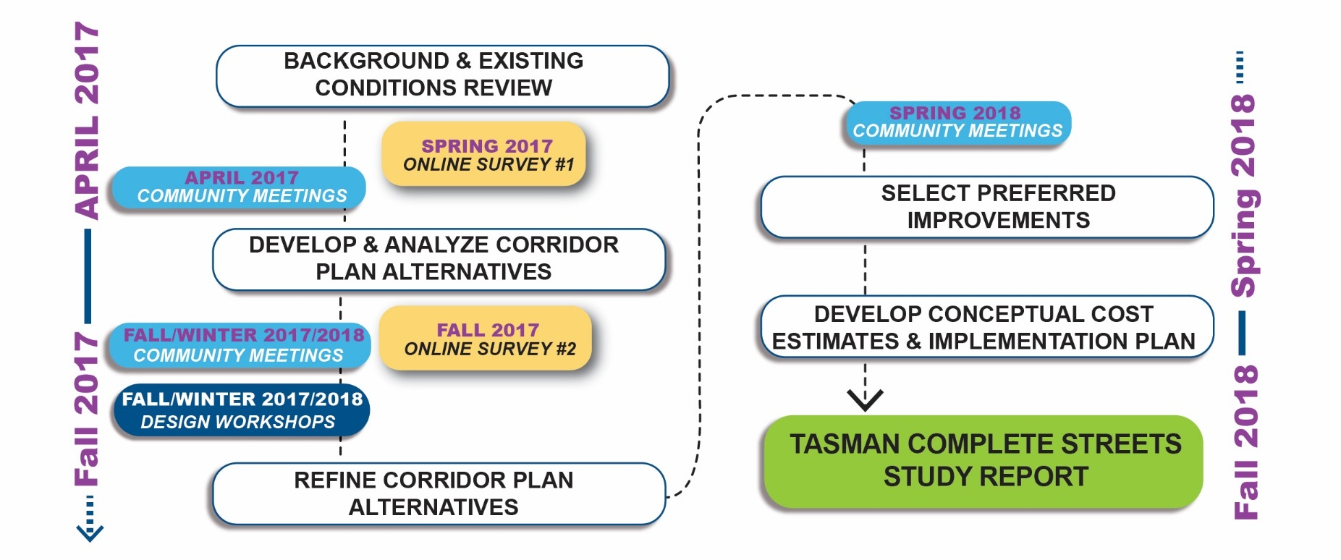
Study Process

Slide 8
Existing Conditions

Slide 9
Activity Levels
Average of 11,550 weekday light rail boardings and alightings at stations along corridor, plus thousands more passing through corridor
Over 18,000 daily autos in some segments
Several intersections with over 100 pedestrian crossings per hour
Four major regional bicycle/pedestrian trails cross the corridor

Slide 10
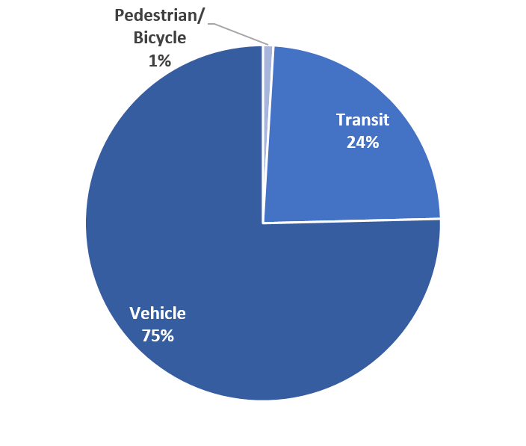
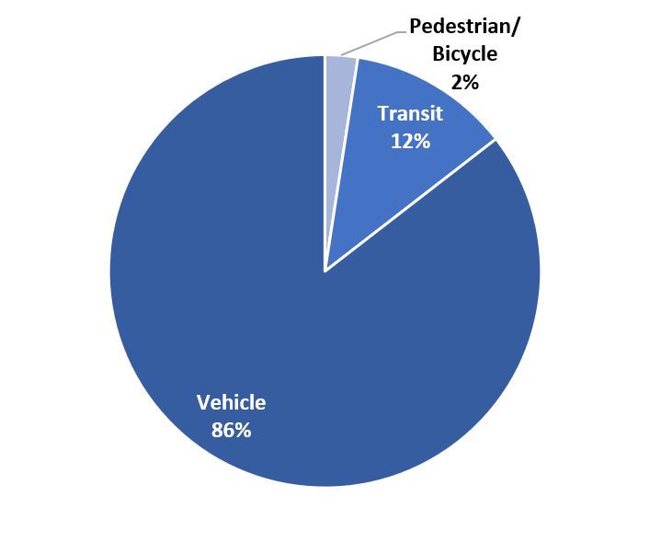
Current Mode Split, Weekday 8-9 AM
Santa Clara
Tasman & Great America
(West Leg)
San Jose
Tasman & Cisco Way
(West Leg)
Based on 2015/2016 auto, bicycle, and pedestrian volumes and 2016 VTA LRT Ridership

Slide 11
Light Rail Activity
Busiest Stations are:
  Tasman (1,914 daily boardings, including transfers)
  Great Mall (1,107 daily boardings)
  Old Ironsides (376 daily boardings)
  I-880 (369 daily boardings)
64 trips per day in each direction west of Tasman, 68 trips per day in each direction east of Tasman
New Mountain View – Alum Rock service will be starting later this year

Slide 12
Traffic Volumes
Traffic volumes highest near I-880 and in Milpitas
Traffic heaviest eastbound in evening
Some congestion westbound in morning

Slide 13
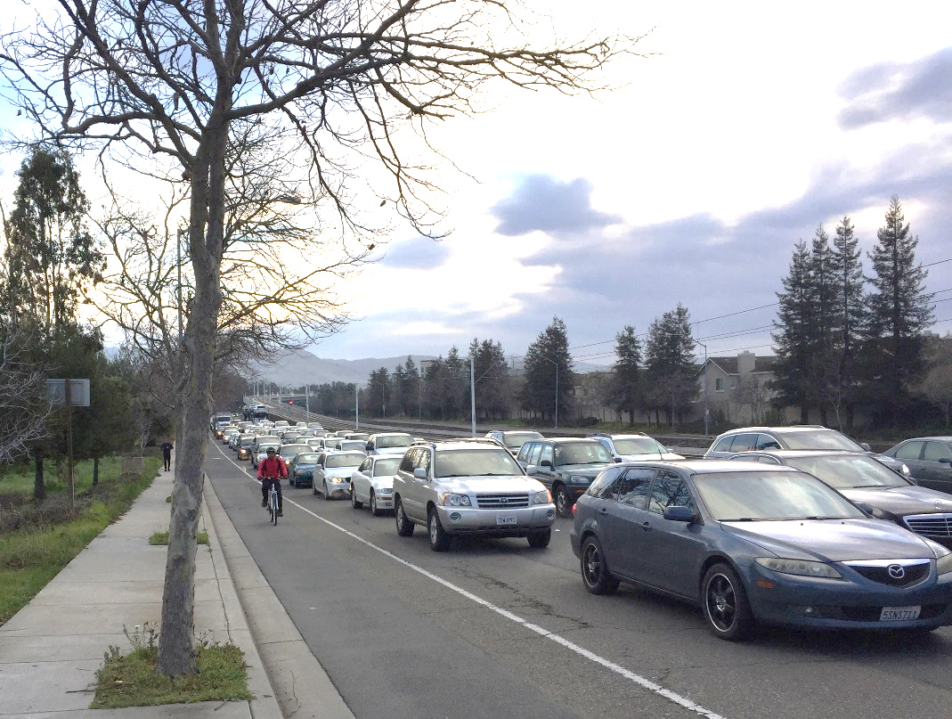
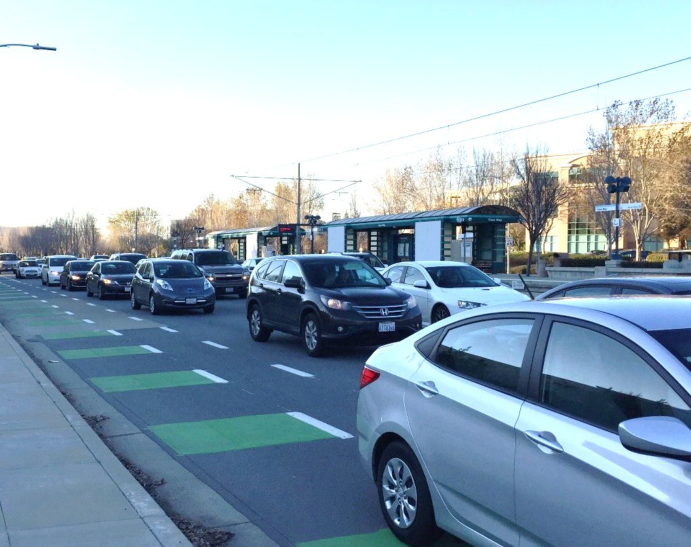
Traffic Congestion During Peak Times
Great Mall Parkway, East of I-880
Tasman Drive, West of Cisco Way

Slide 14
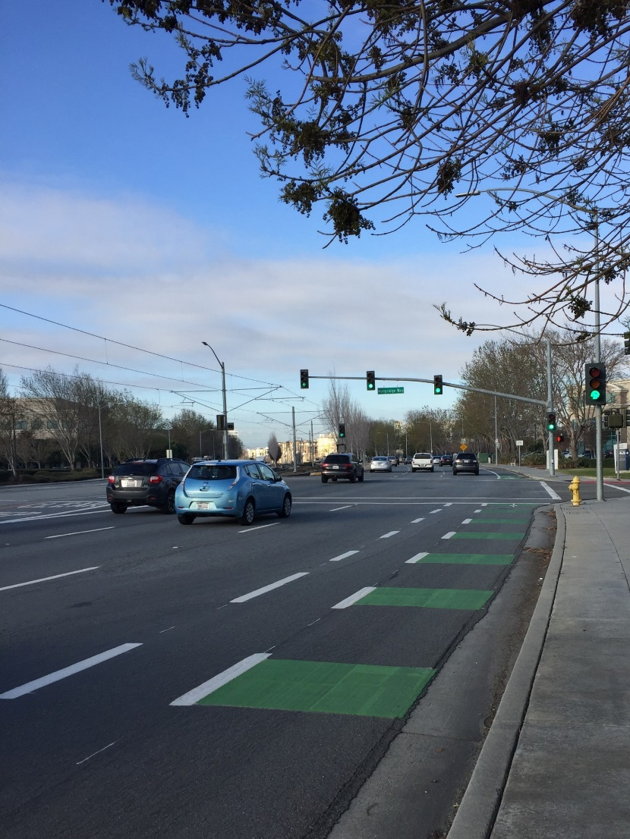
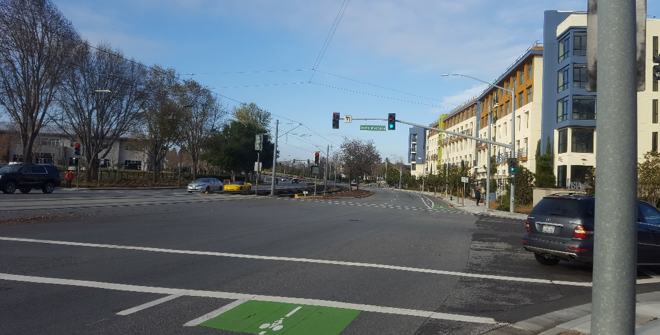
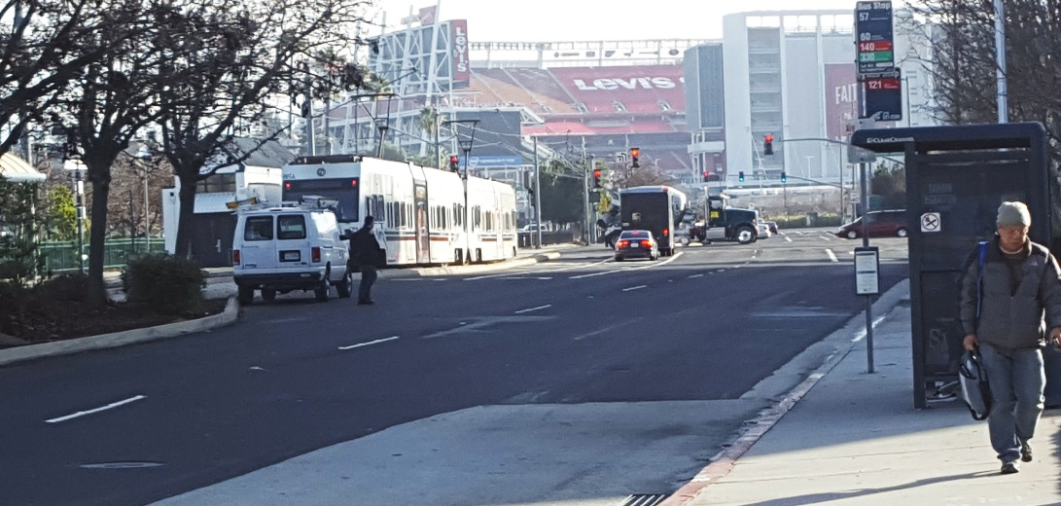
Excess Capacity During Off-Peak Times
Tasman & Vista Montaña
Tasman & Morgridge
Tasman & Old Ironsides

Slide 15
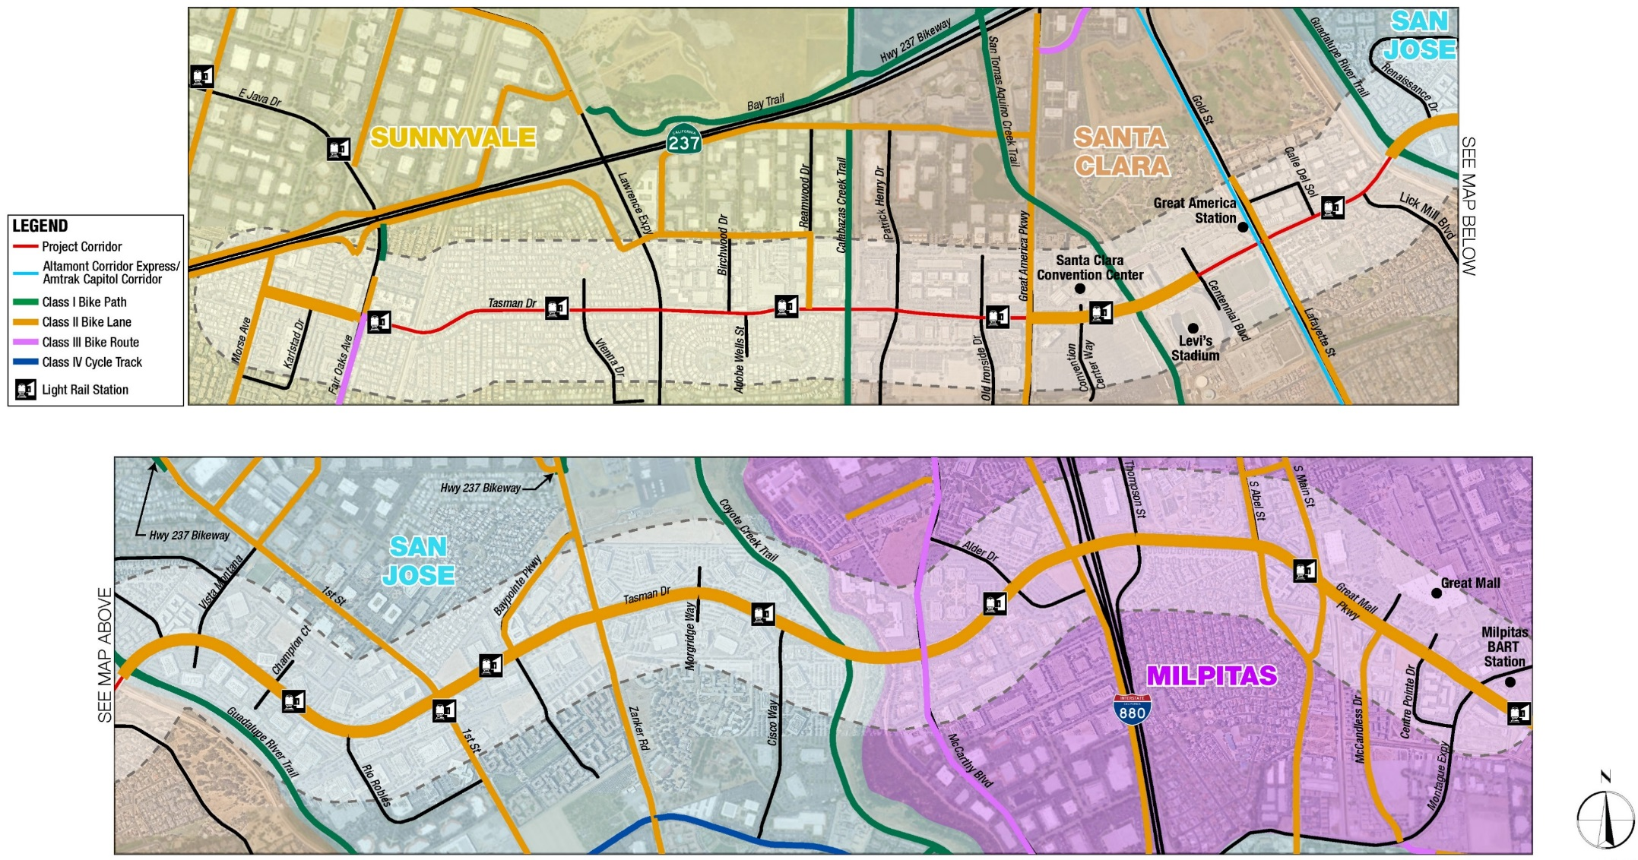
Bicycle Facilities

Slide 16
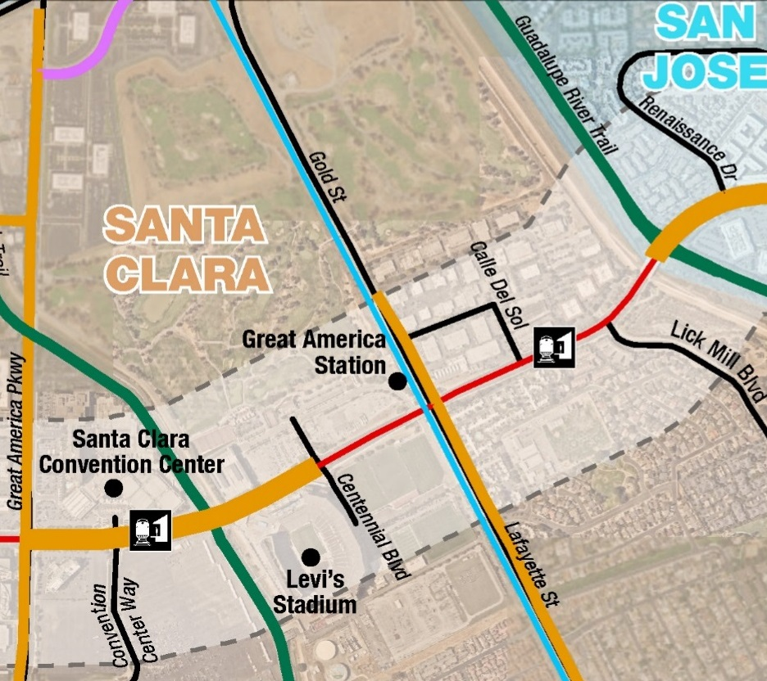
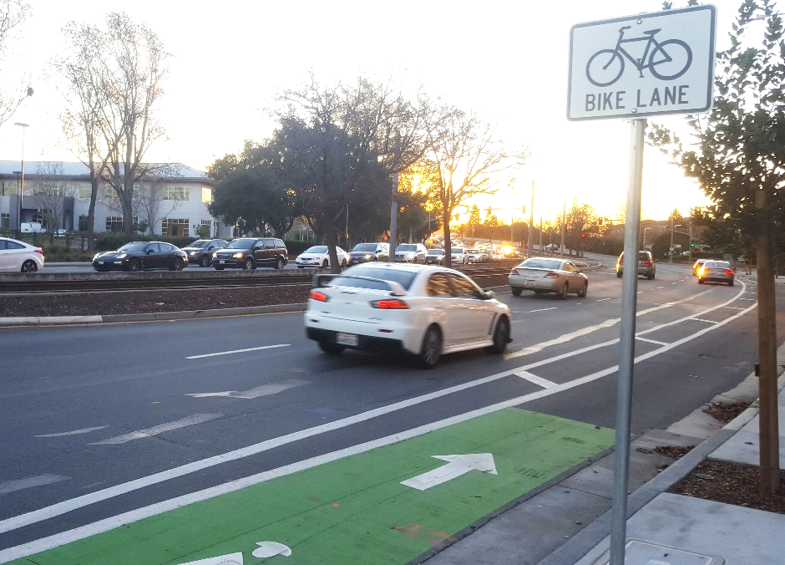
Bike Lane Improvement in Santa Clara
Extend recently completed buffered bicycle lanes to Lick Mill Blvd
Tasman & Vista Montaña

Slide 17
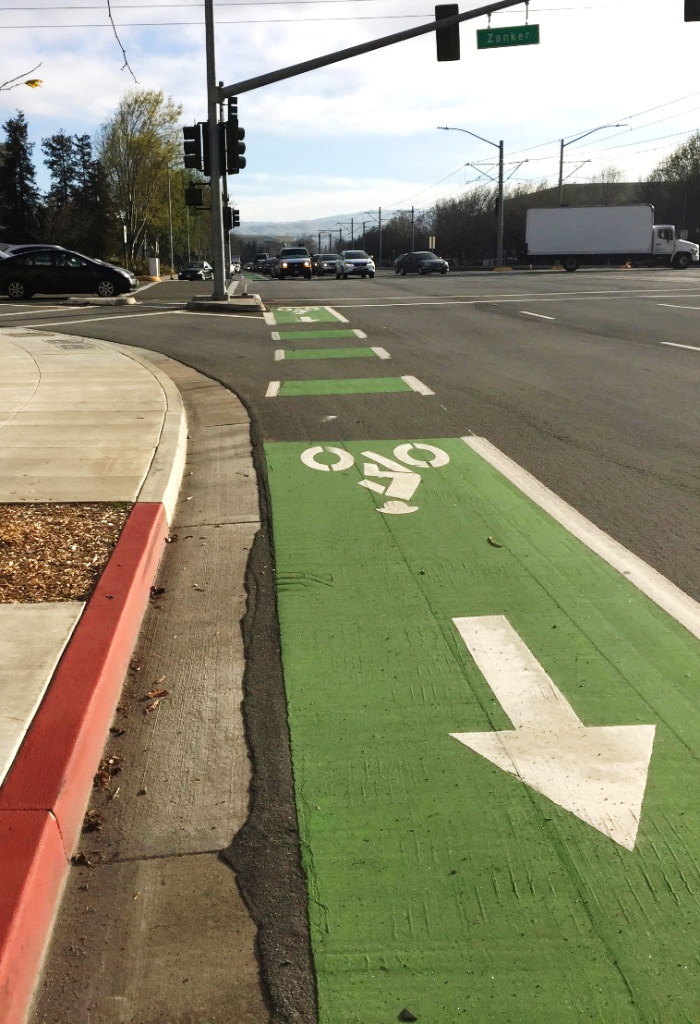
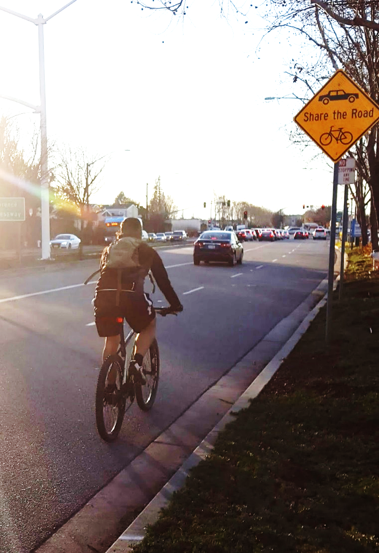
Bicycle Facilities
Tasman & Zanker
Tasman & Lawrence

Slide 18
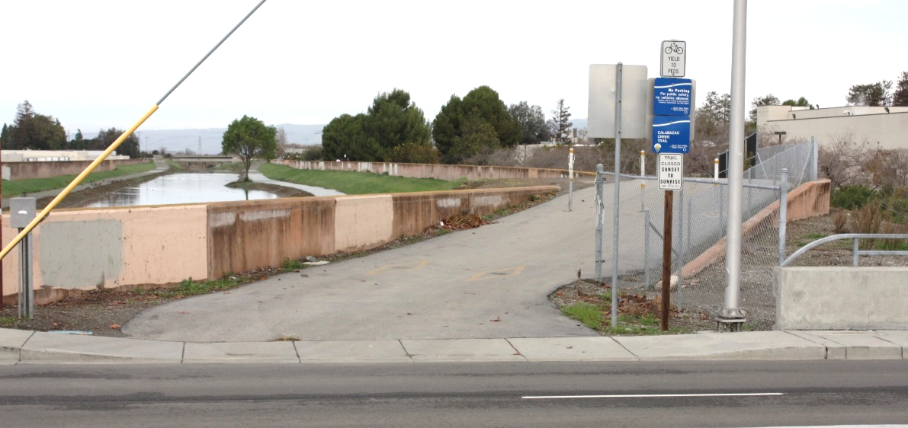
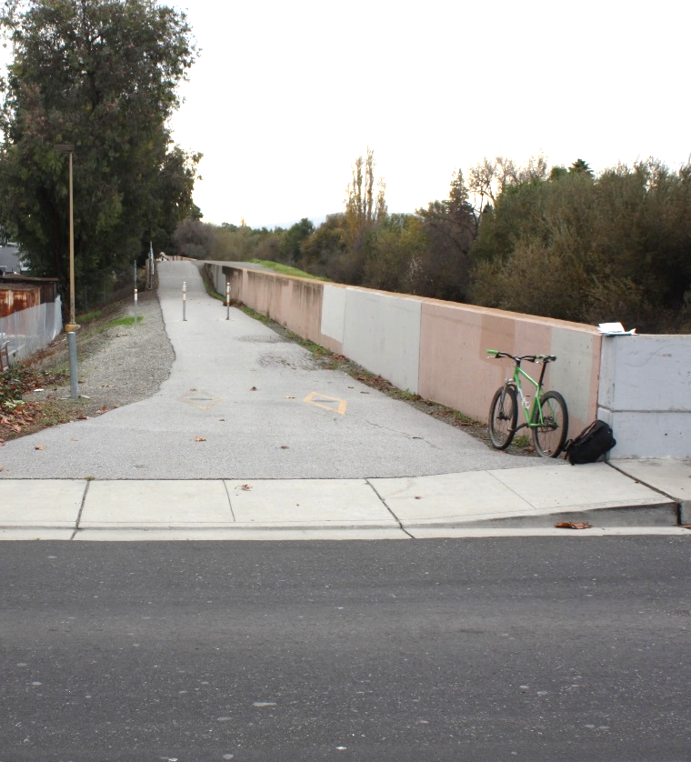
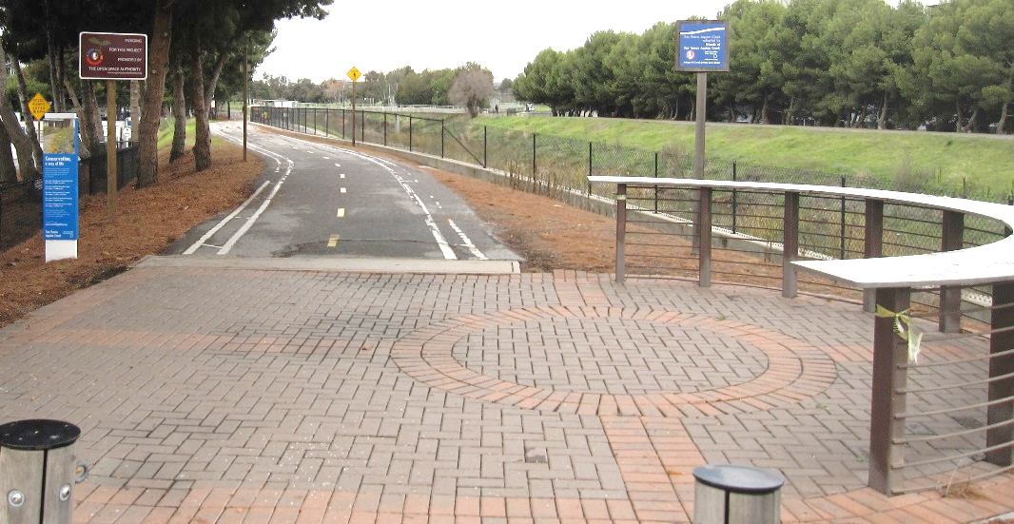
Regional Trail Connections
Calabazas Creek Trail
San Tomas Aquino Creek Trail
Guadalupe River Trail
Coyote Creek Trail
Calabazas Creek Trail
San Tomas Aquino Creek Trail
Calabazas Creek Trail

Slide 19
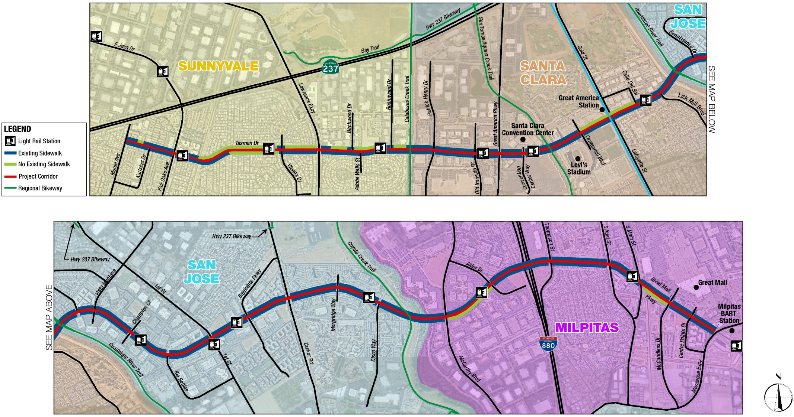
Pedestrian Facilities

Slide 20
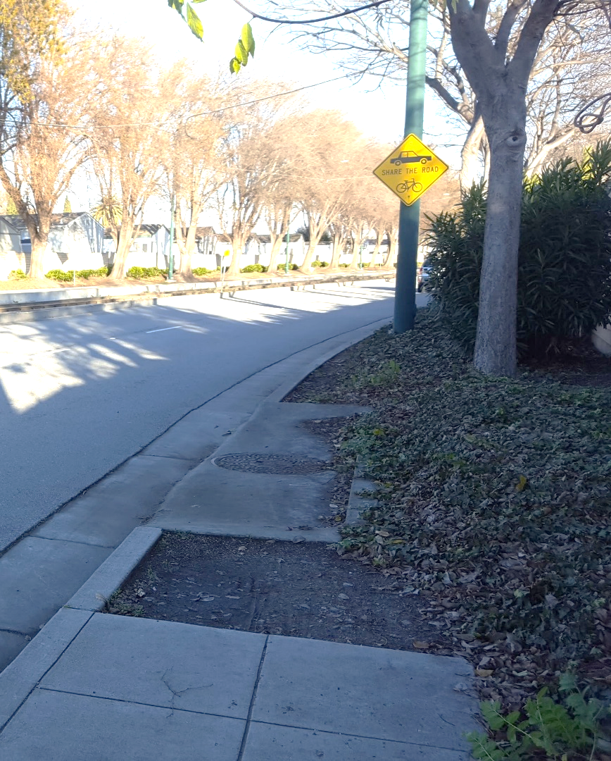
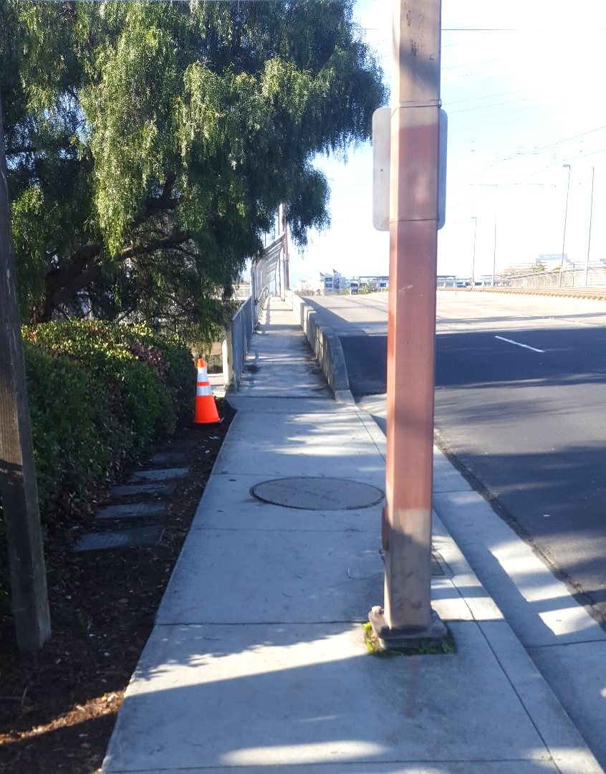
Sidewalk Facilities
Tasman & Calle del Sol
Tasman & Tasman Ct

Slide 21
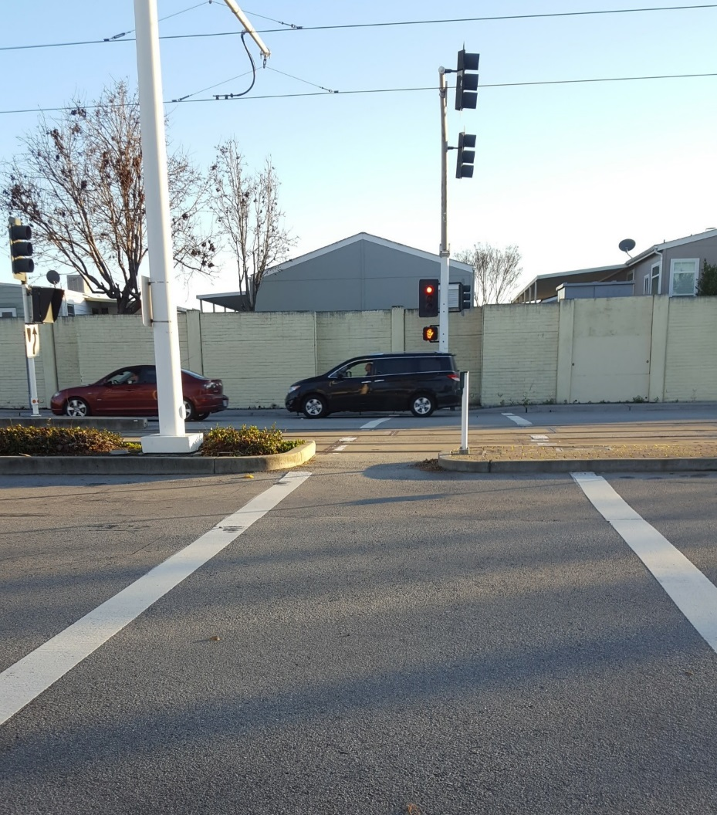
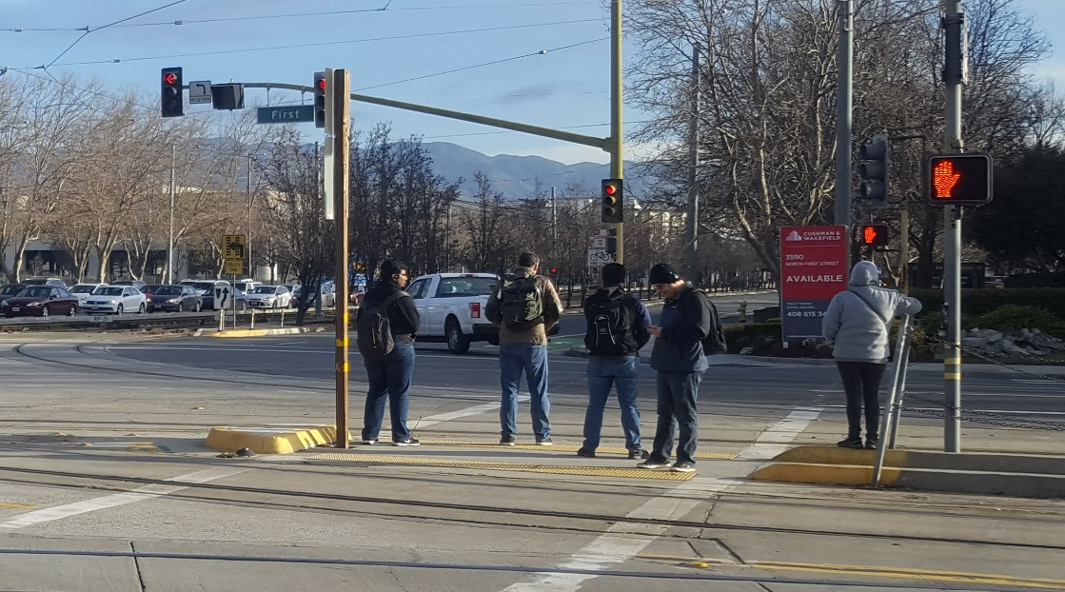
Pedestrian Crossings
Tasman & N First
Tasman & Birchwood

Slide 22
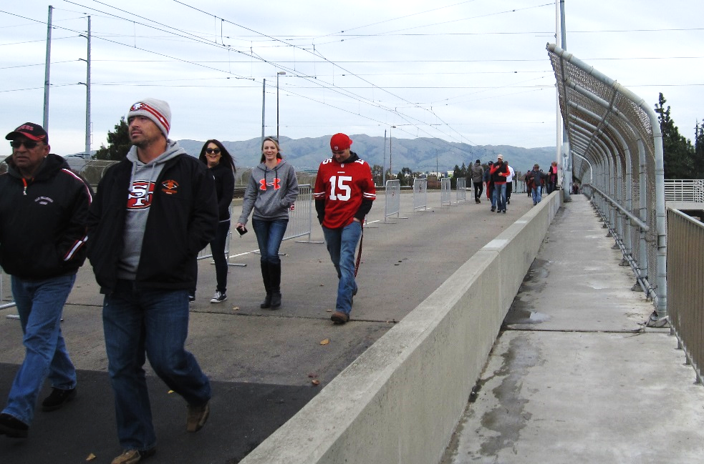
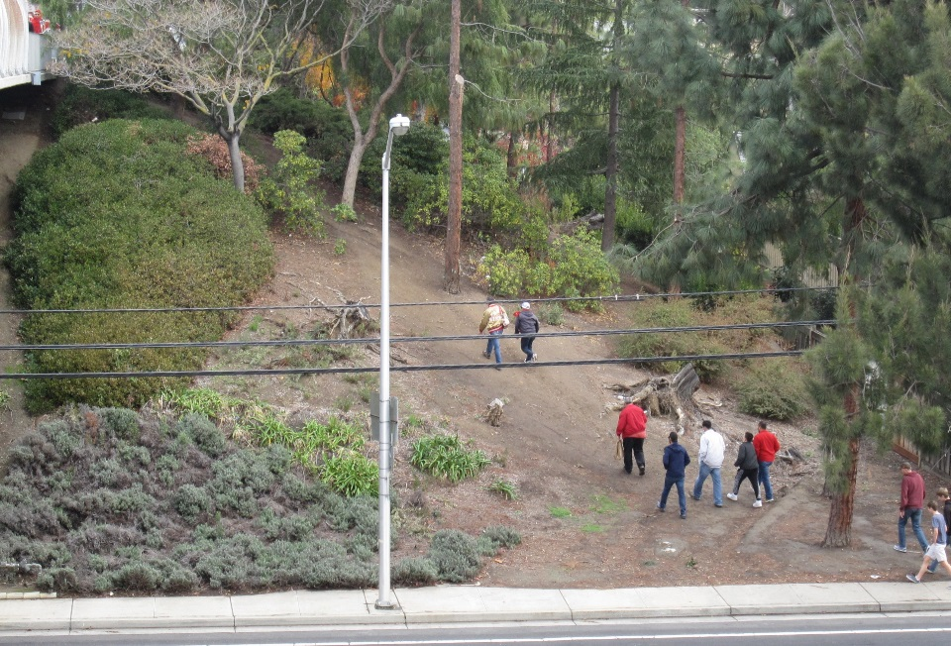
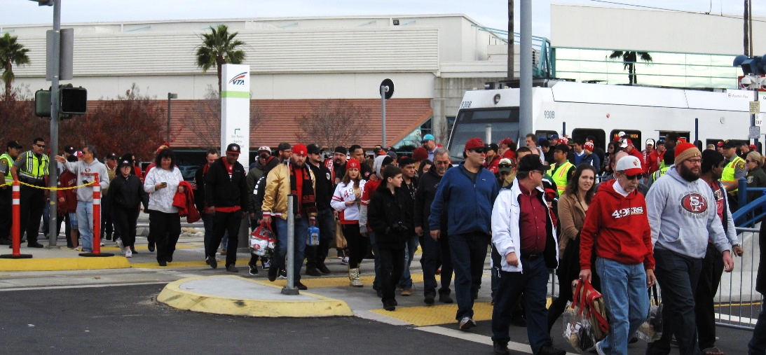
Levi Stadium Access

Slide 23
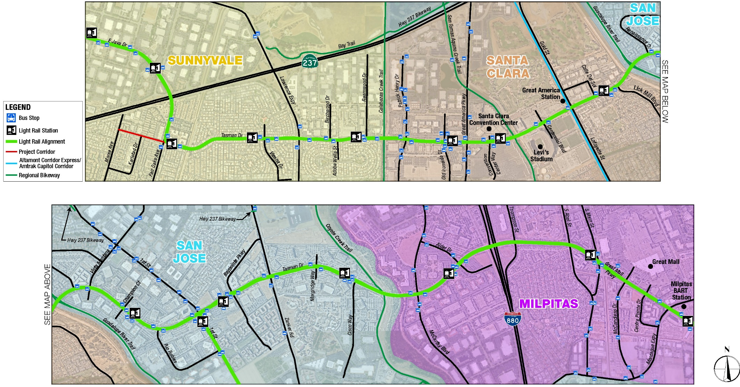
Transit Facilities

Slide 24
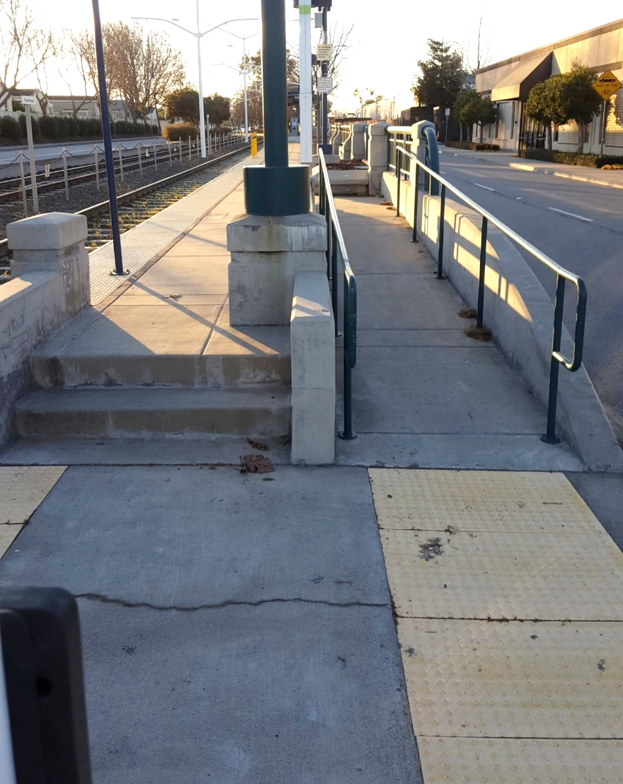
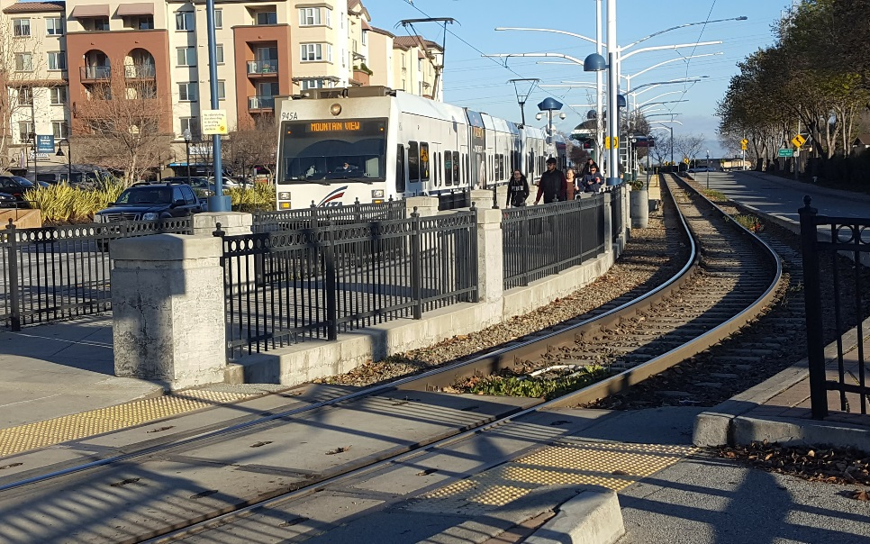
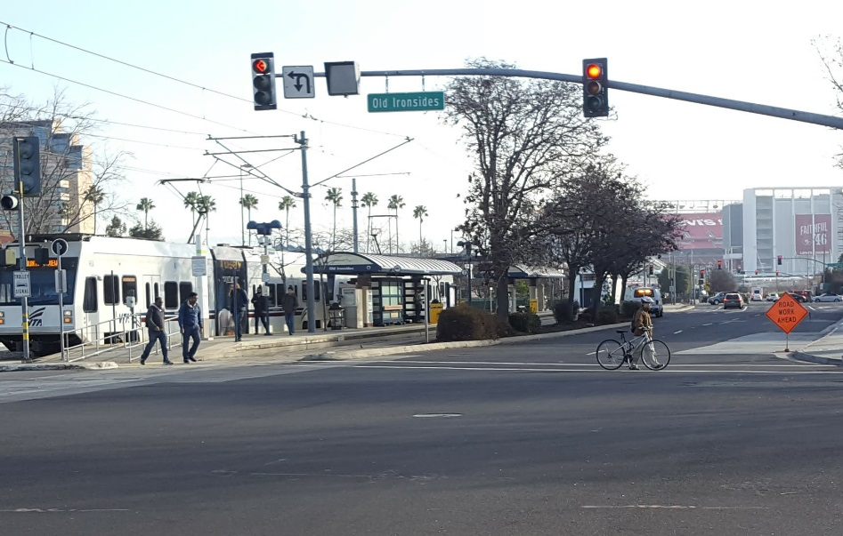
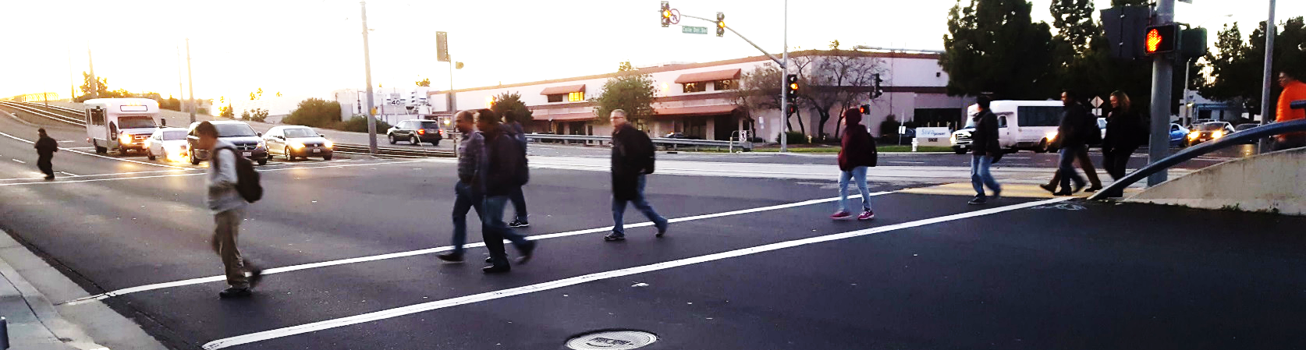
Access to LRT Stations

Slide 25
Collisions
Higher Frequency Collision Locations
Higher Frequency Pedestrian/Bicycle Collision Locations
Lawrence Expressway
Montague Expressway
Fair Oaks Avenue
Thompson Street
Great America Parkway
First Street
Zanker Drive
Alder Drive
Montague Expressway
Calle Del Sol
Lawrence Expressway
Rio Robles
S Main Street
Centre Point Drive

Slide 26
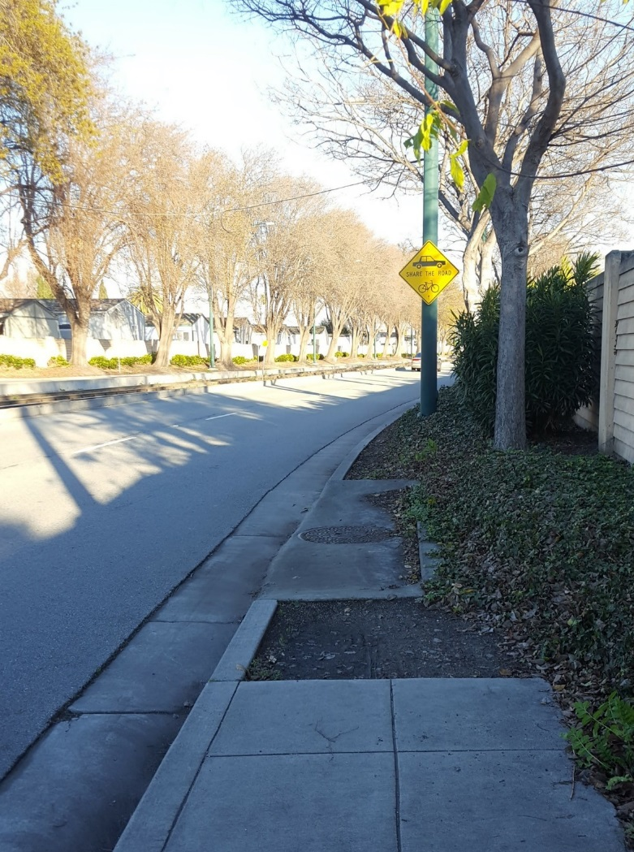
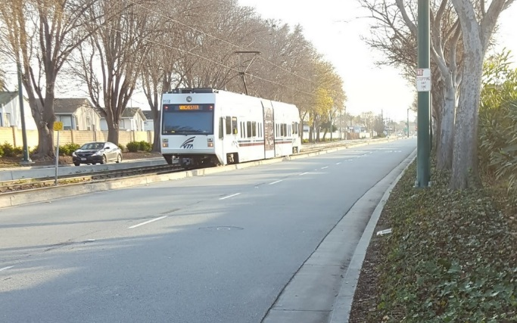
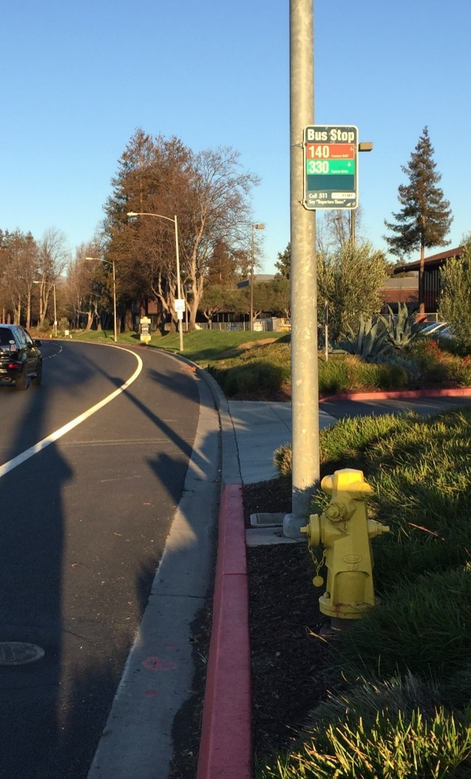
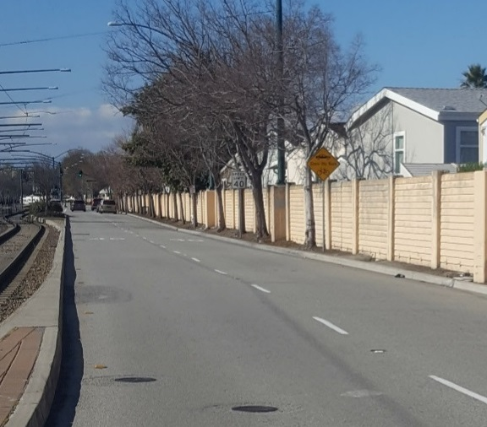
Sunnyvale Missing Bicycle Lanes & Sidewalks

Slide 27
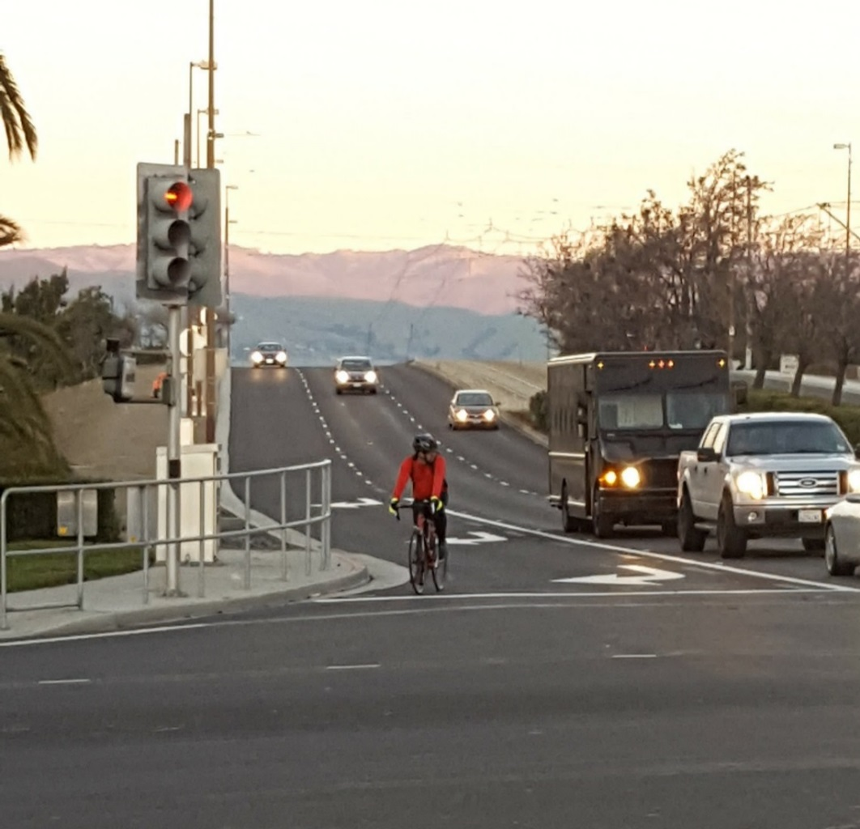
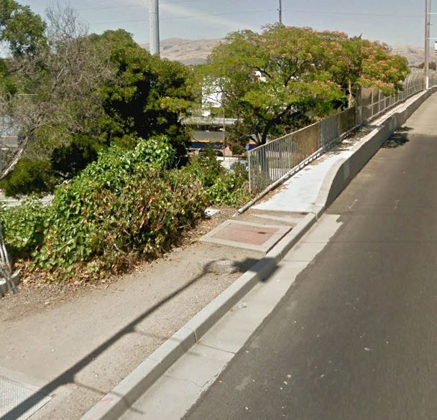
Santa Clara Missing Sidewalks

Slide 28
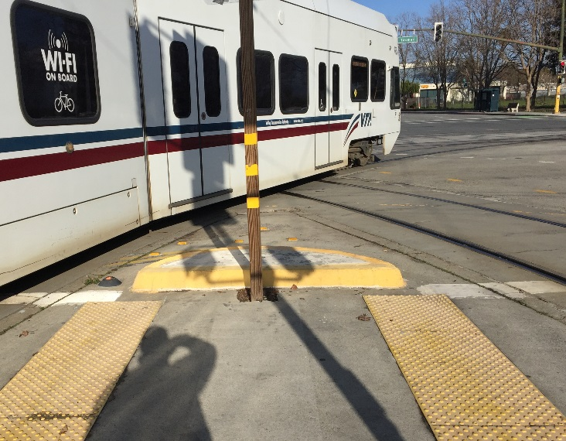
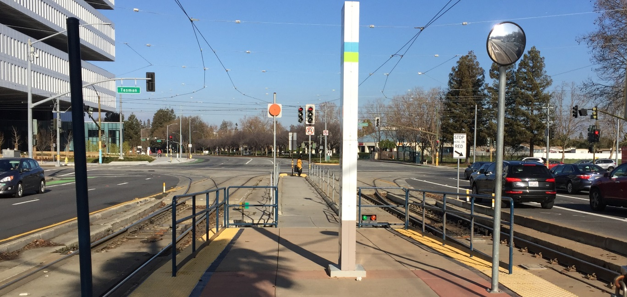
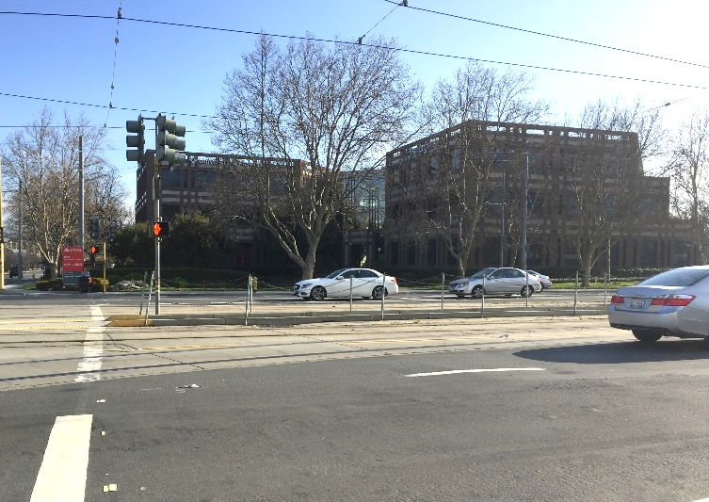
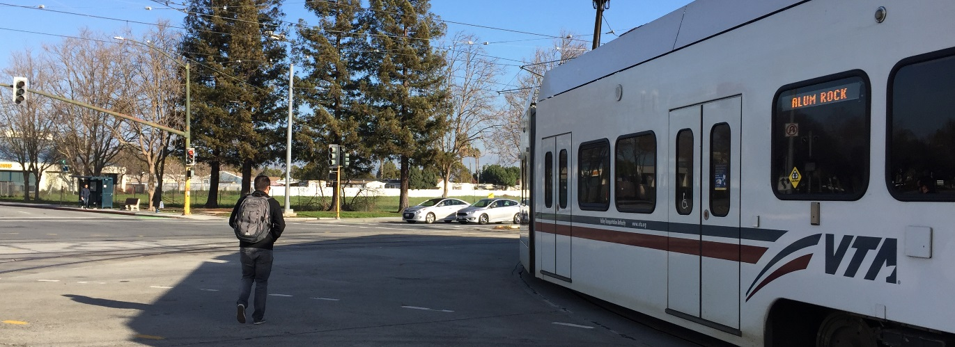
N 1st St & Tasman

Slide 29
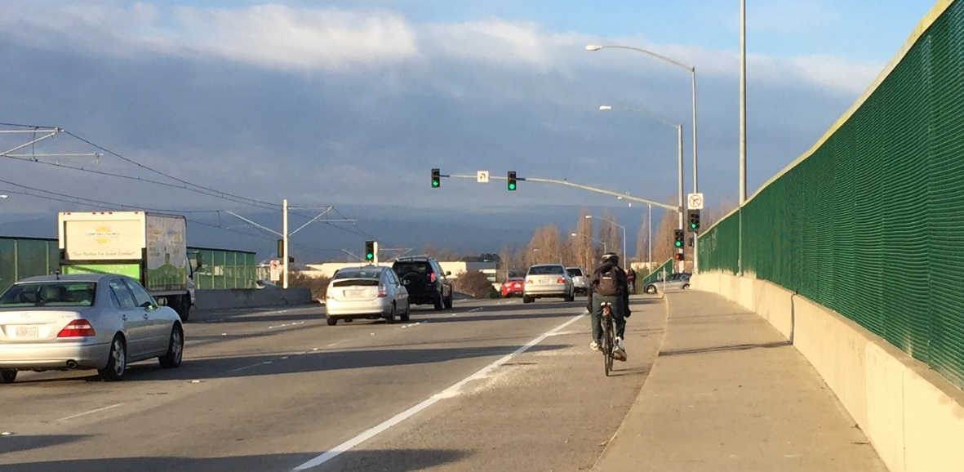
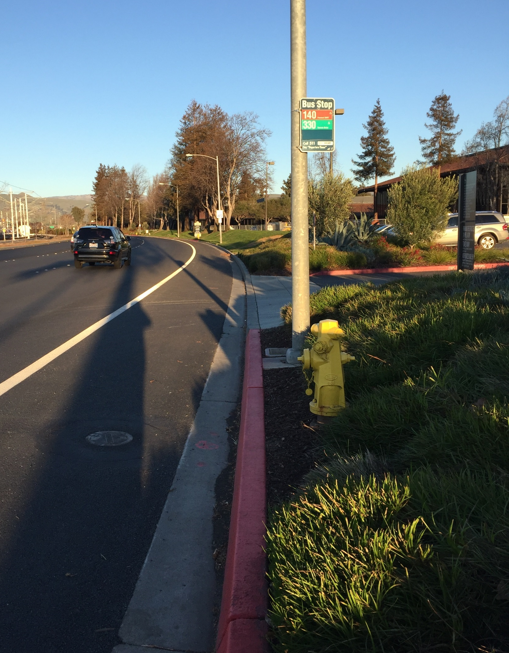
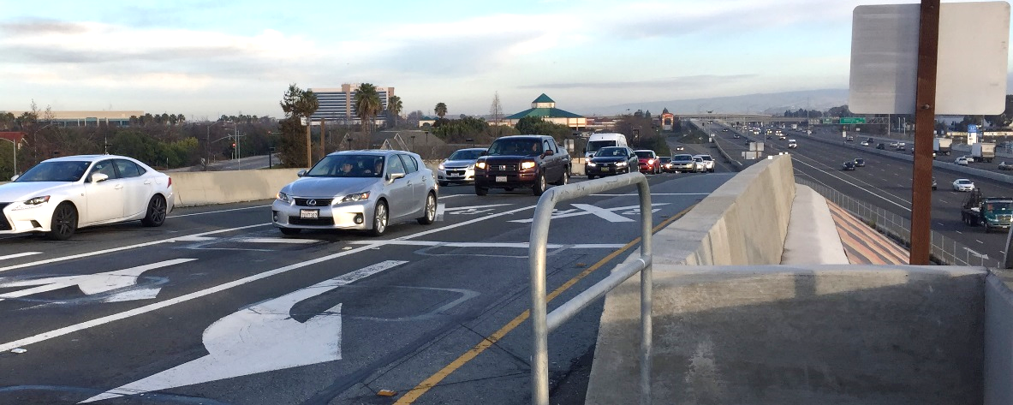
Tasman & I-880 Interchange

Slide 30
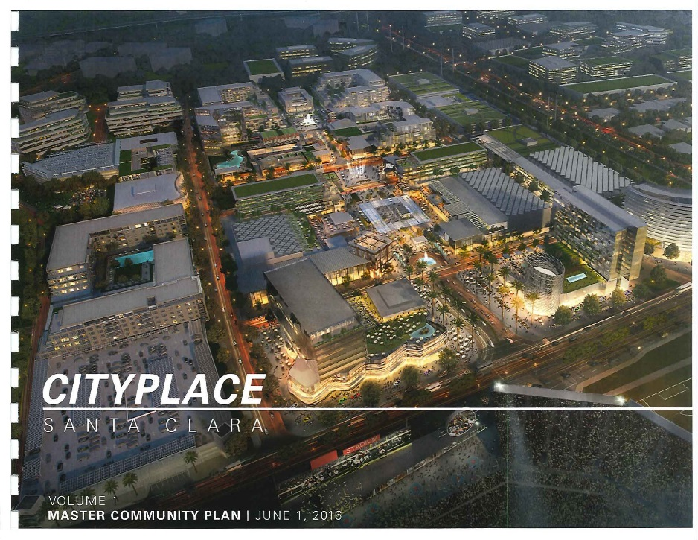
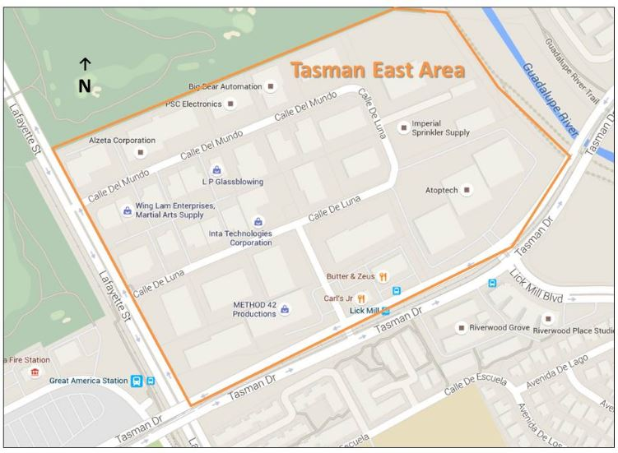
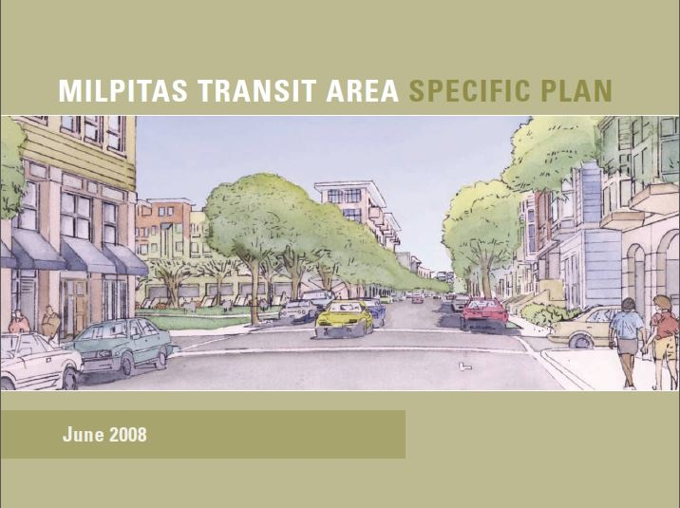
Future Growth

Slide 31
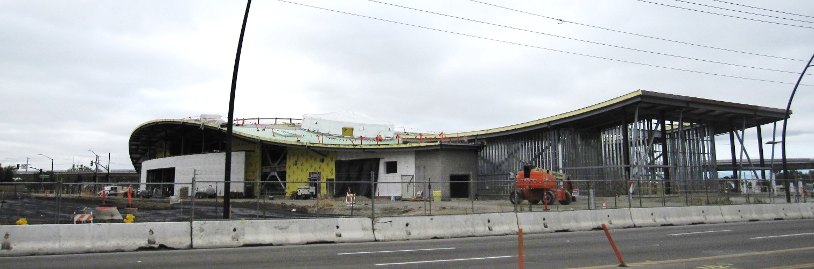

VTA’s BART Extension and Next Network

Slide 32
Improvement Examples

Slide 33




Bicycle Improvement Examples

Slide 34





Pedestrian Improvement Examples

Slide 35




Transit Improvement Examples

Slide 36
Next Steps

Slide 37

Study Process

Slide 38


Online Survey
tasmansurvey.vta.org

Slide 39
PROJECT INFORMATION
VTA Community Outreach
CALL US:
Phone: (408) 321-7575
TTY Only: (408) 321-2330
EMAIL US:
community.outreach@vta.org
VISIT US:
http://www.vta.org/tasmanstudy

Slide 40
Input Activity

Slide 41
Station One
Where do you live/What modes do you use on the corridor?
Place a dot on the map and on the board.

Slide 42
Station Two
What do you use the corridor for?
Write how you use the corridor on the board.

Slide 43
Station Three
Identify improvement priorities for the corridor.
Place a dot on the areas of highest priority.

Slide 44
Station Four
Identify specific areas in need of improvement along the corridor.
Place a sticky note on the aerial map.

Slide 45
PROJECT INFORMATION
VTA Community Outreach
CALL US:
Phone: (408) 321-7575
TTY Only: (408) 321-2330
EMAIL US:
community.outreach@vta.org
VISIT US:
http://www.vta.org/tasmanstudy

