Slide 1
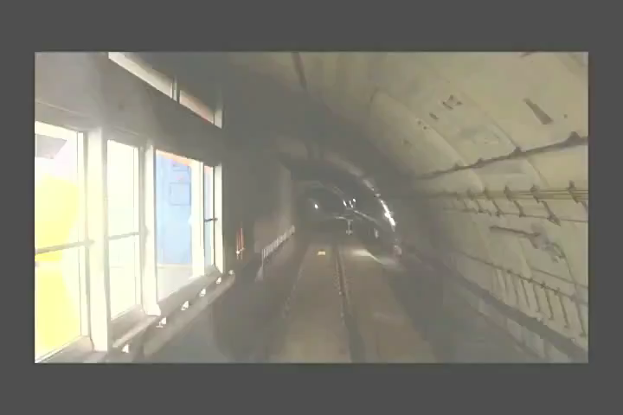
Single-bore Train Operations

