Slide 1
Public Open House
I-280 / Wolfe Road
Interchange Improvements Project
Collins Elementary School
Cupertino, CA
March 9, 2017

Slide 2

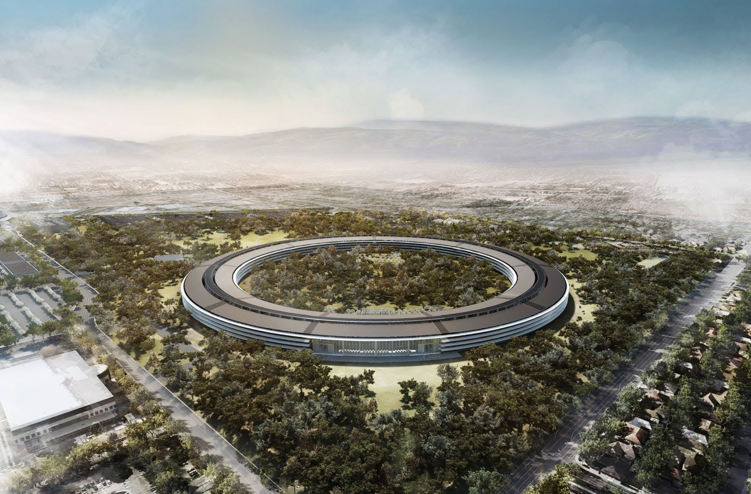
Approved Developments
Apple Campus 2
The Hamptons Apartment Complex
Hyatt House Hotel at Vallco Park

Slide 3



Project Partners
Santa Clara Valley Transportation Authority
City of Cupertino
Caltrans

Slide 4
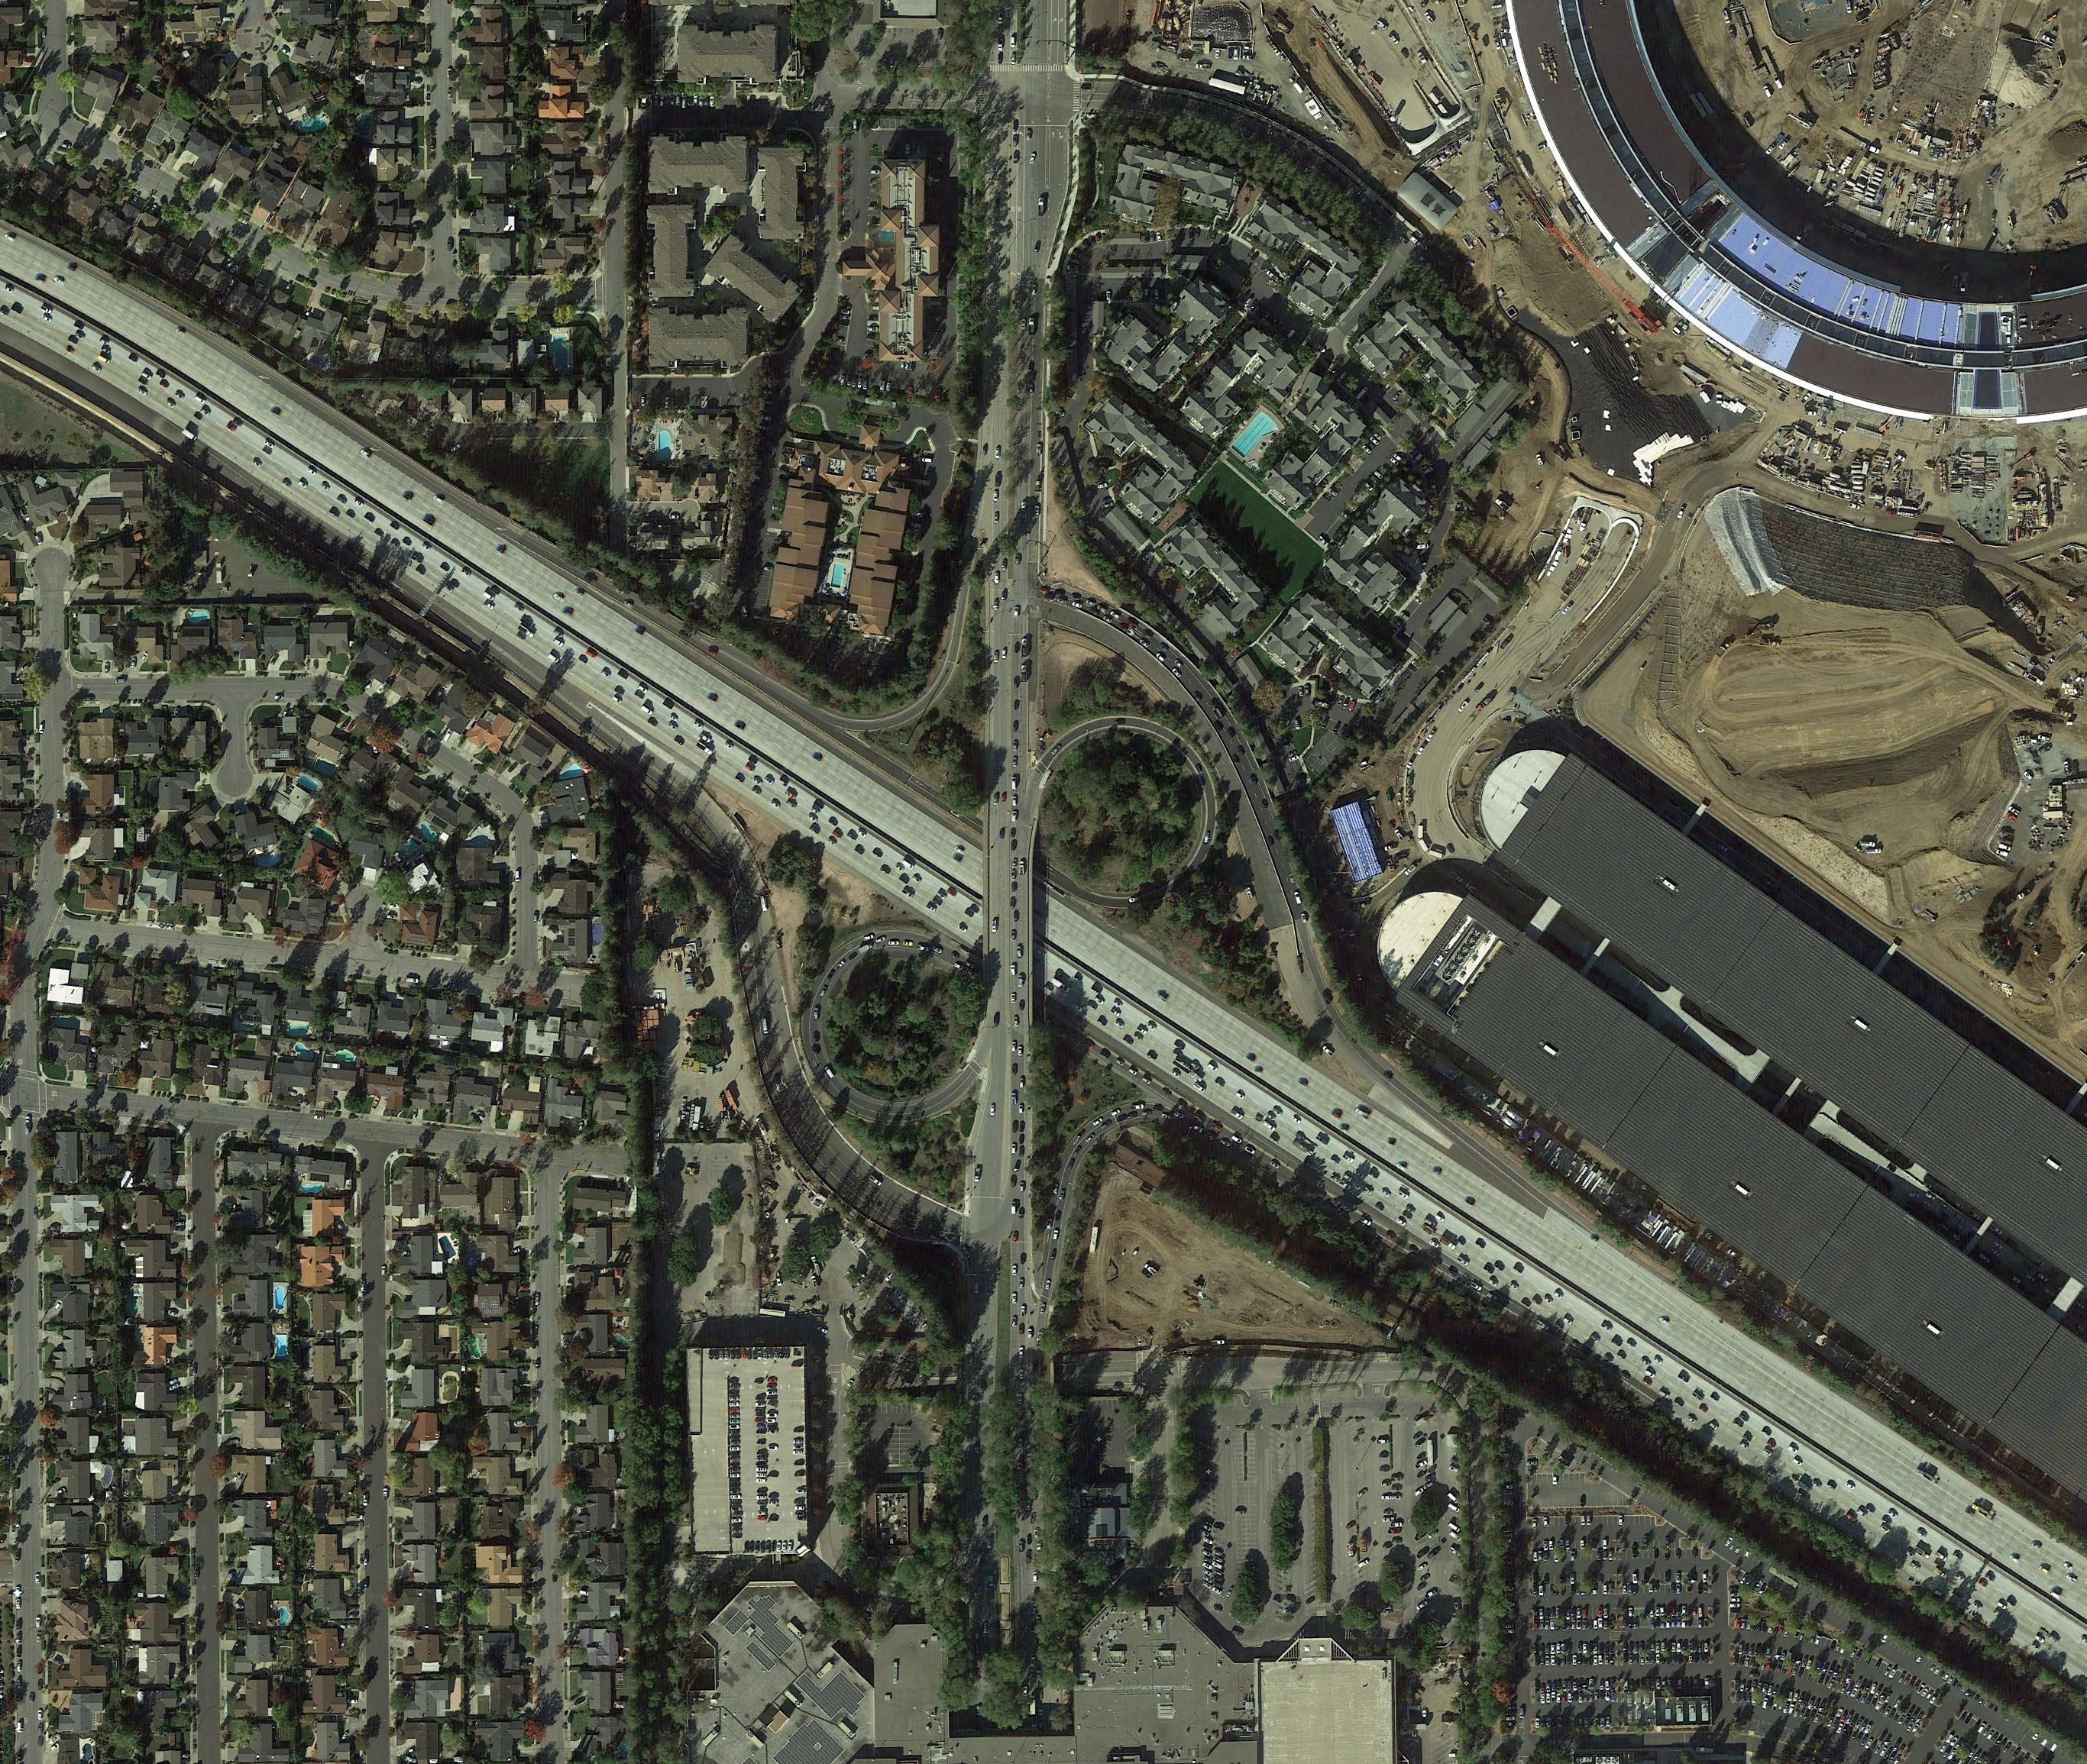


I-280/Wolfe Road Interchange Improvements Existing Conditions
NORTH
APPLE CAMPUS 2
WOLFE ROAD
I-280

Slide 5
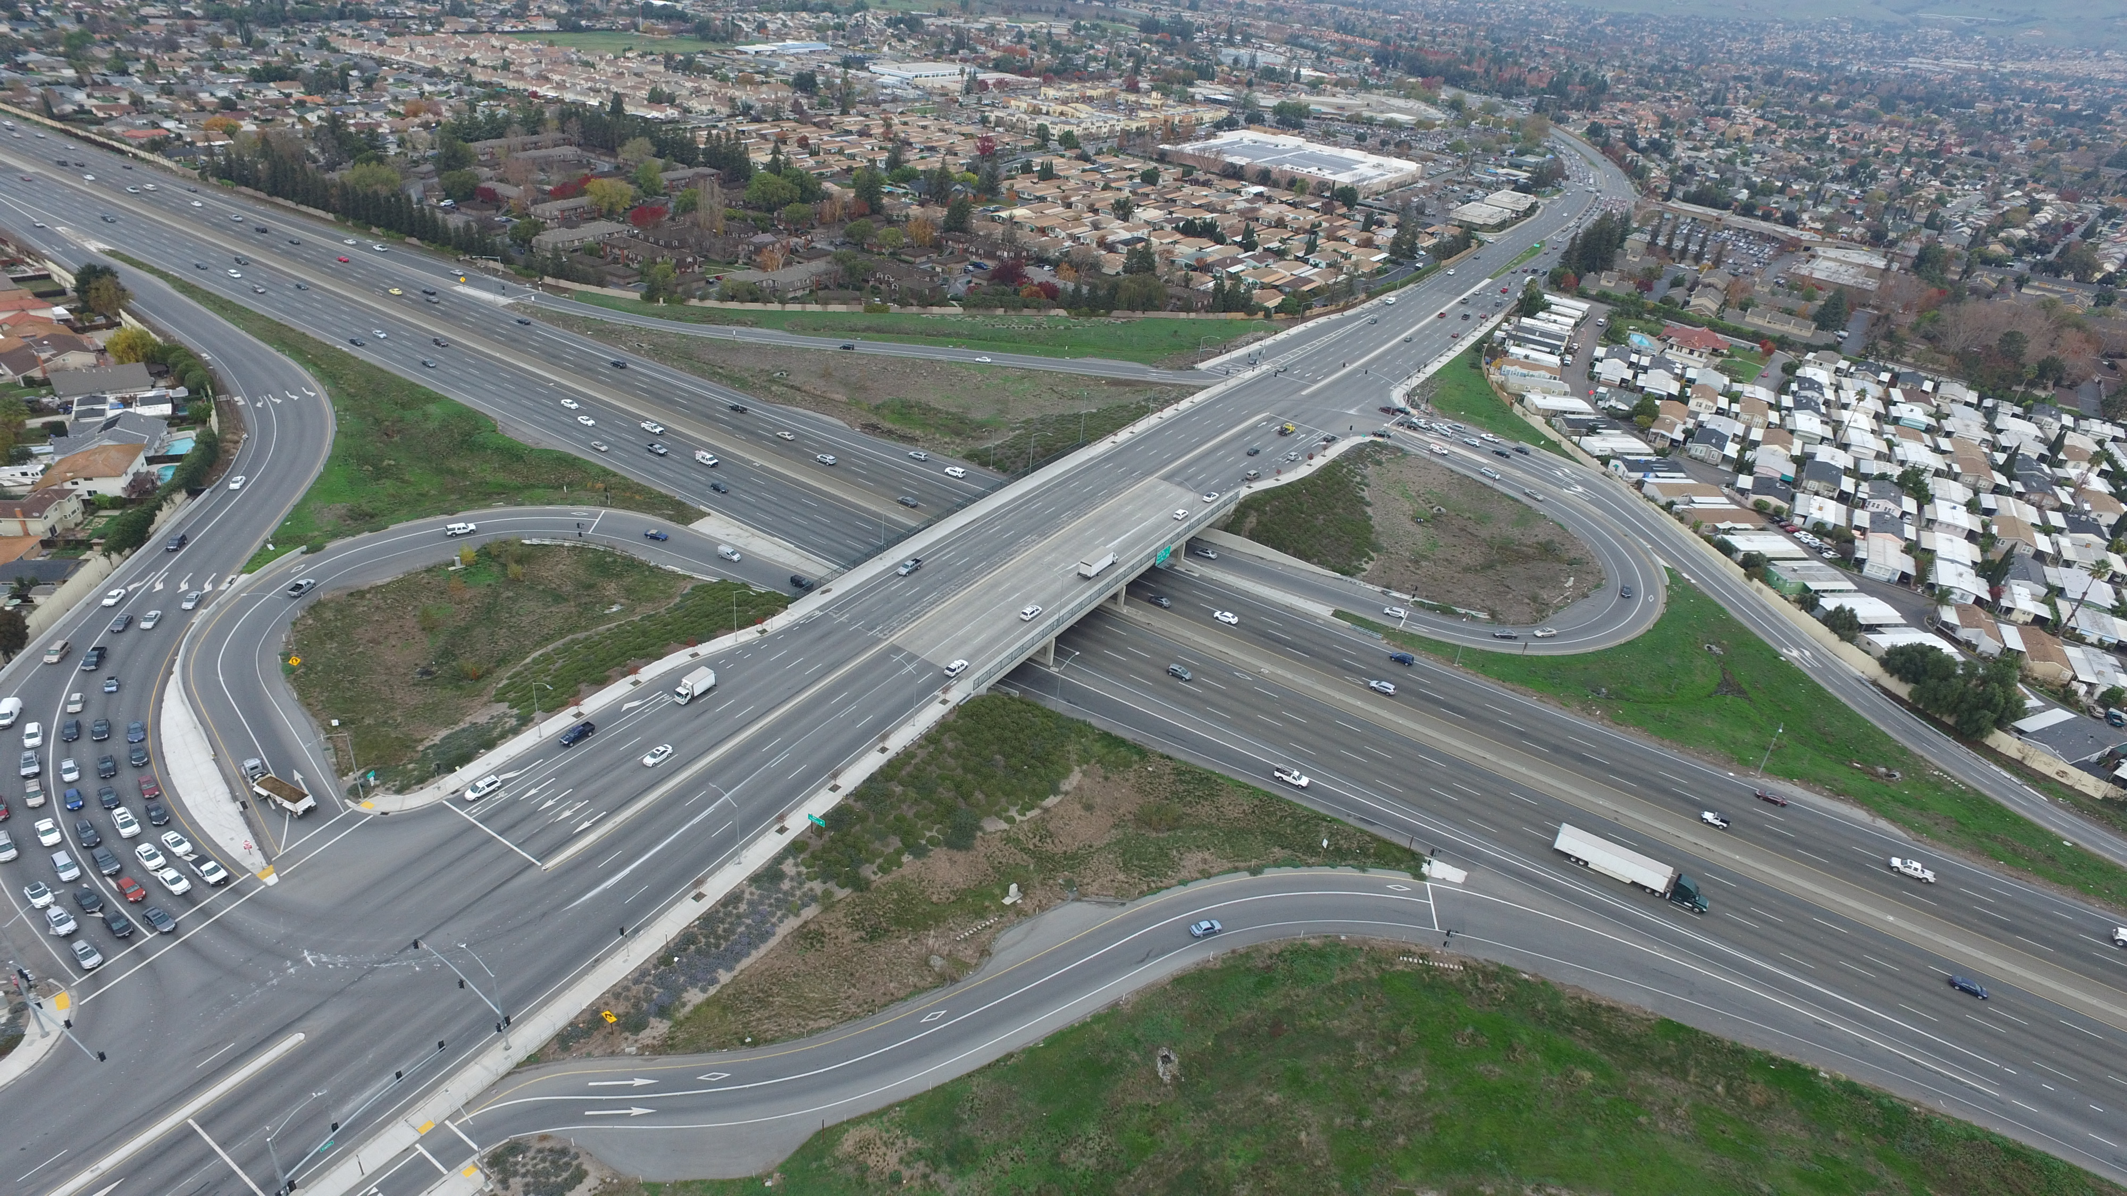
Example - Widened Structure: Partial Cloverleaf Interchange Option (US 101-Capitol Expressway Interchange)

Slide 6
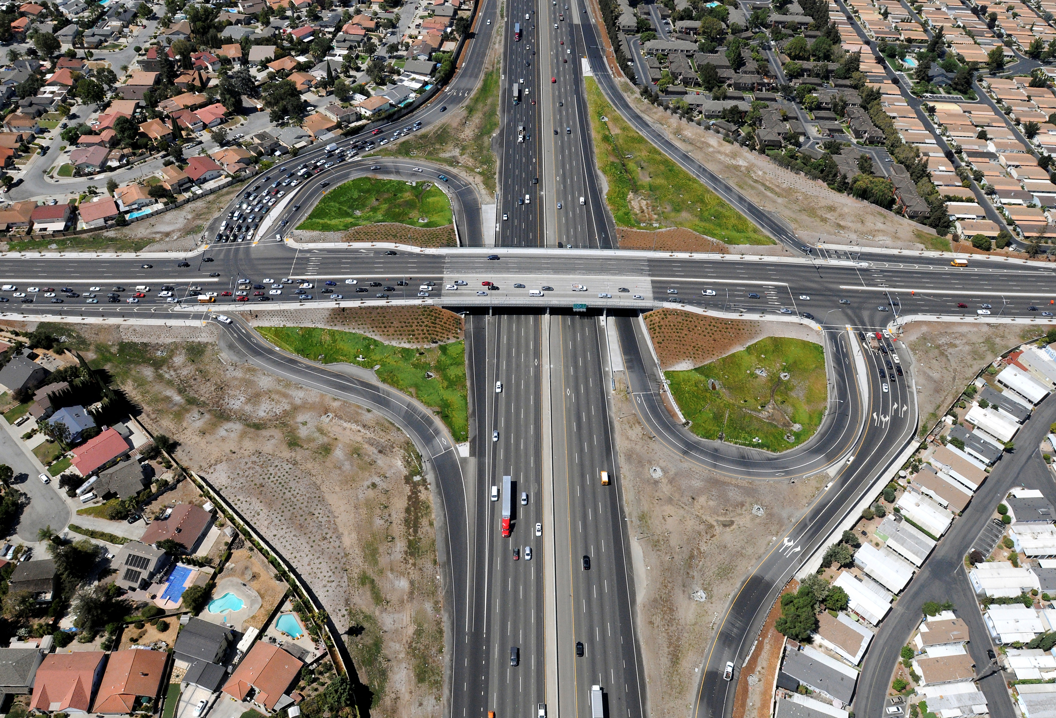
Example - Widened Structure: Partial Cloverleaf Interchange Option (US 101-Capitol Expressway Interchange)

Slide 7
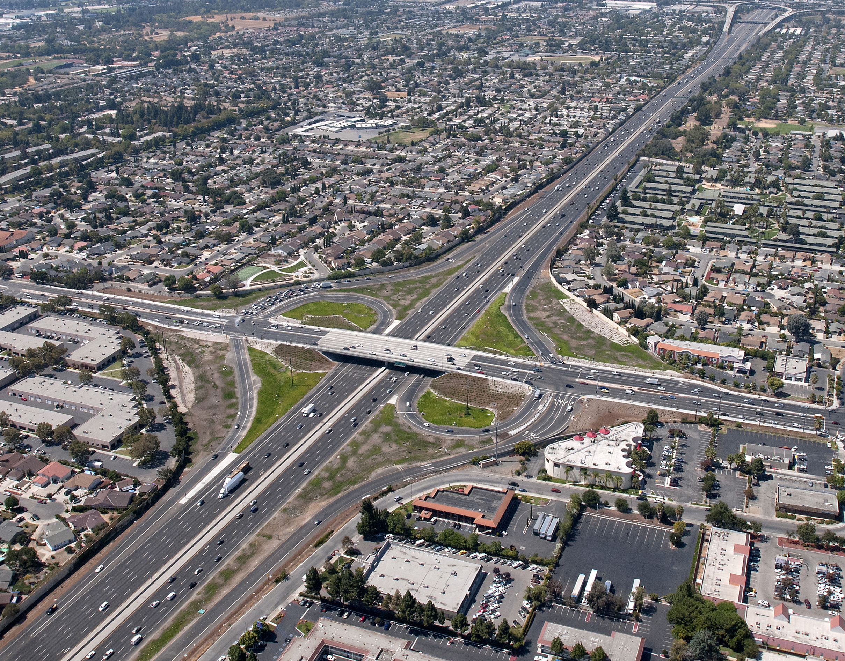
Example - Replaced Structure: Partial Cloverleaf Interchange Option (US 101-Tully Road Interchange)

Slide 8
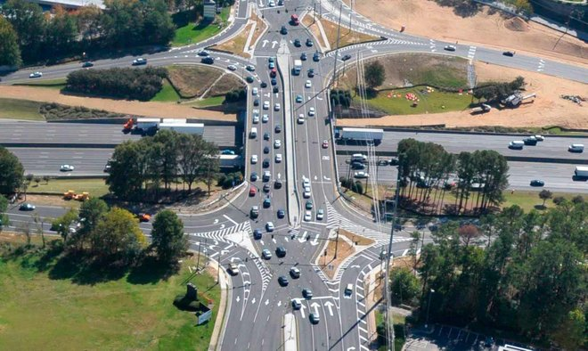
Example - Replaced Structure: Diverging Diamond Interchange Option (I-285, Atlanta, GA)

Slide 9
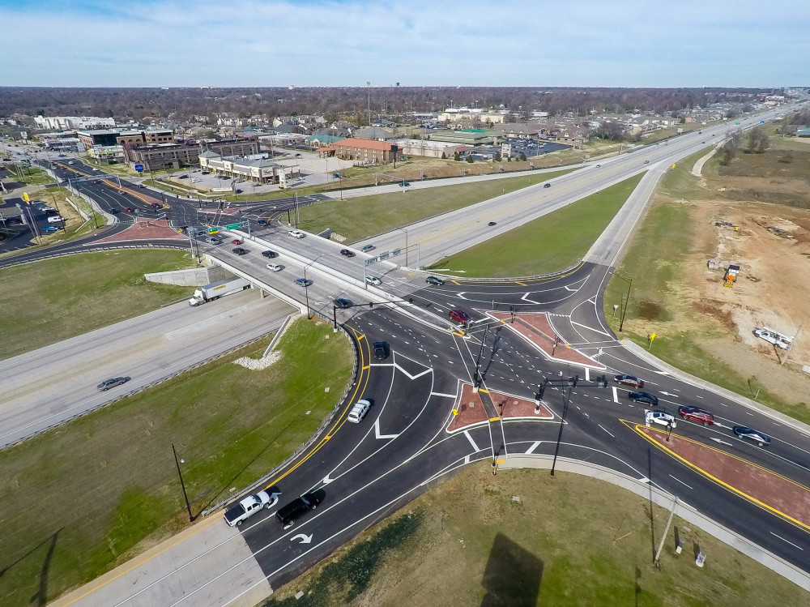
Example - Replaced Structure: Diverging Diamond Interchange Option (US 65, Springfield, MO)

Slide 10
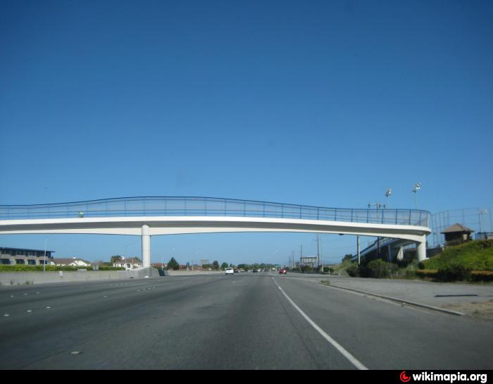
Example - Class I Bicycle and Pedestrian Overcrossing Option (O’Neill Slough 101 Pedestrian Overpass, Belmont, CA)

Slide 11
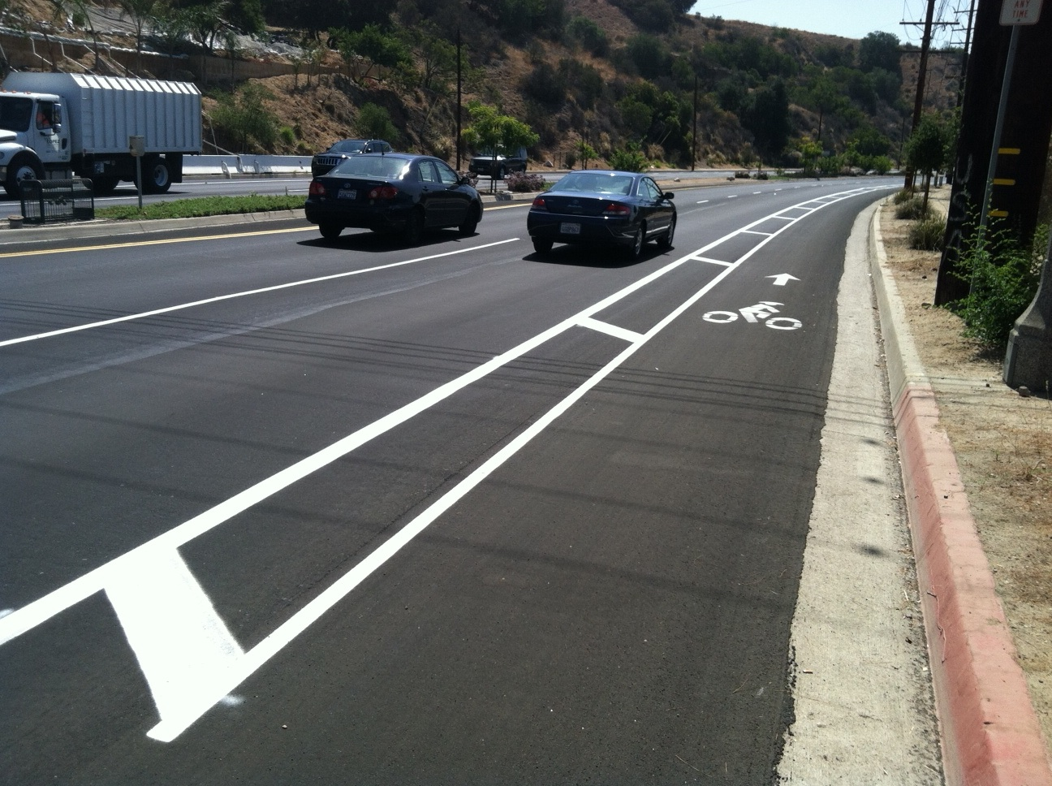
Example - Class II Bike Lane Option Striped buffer between cars and bikes

Slide 12
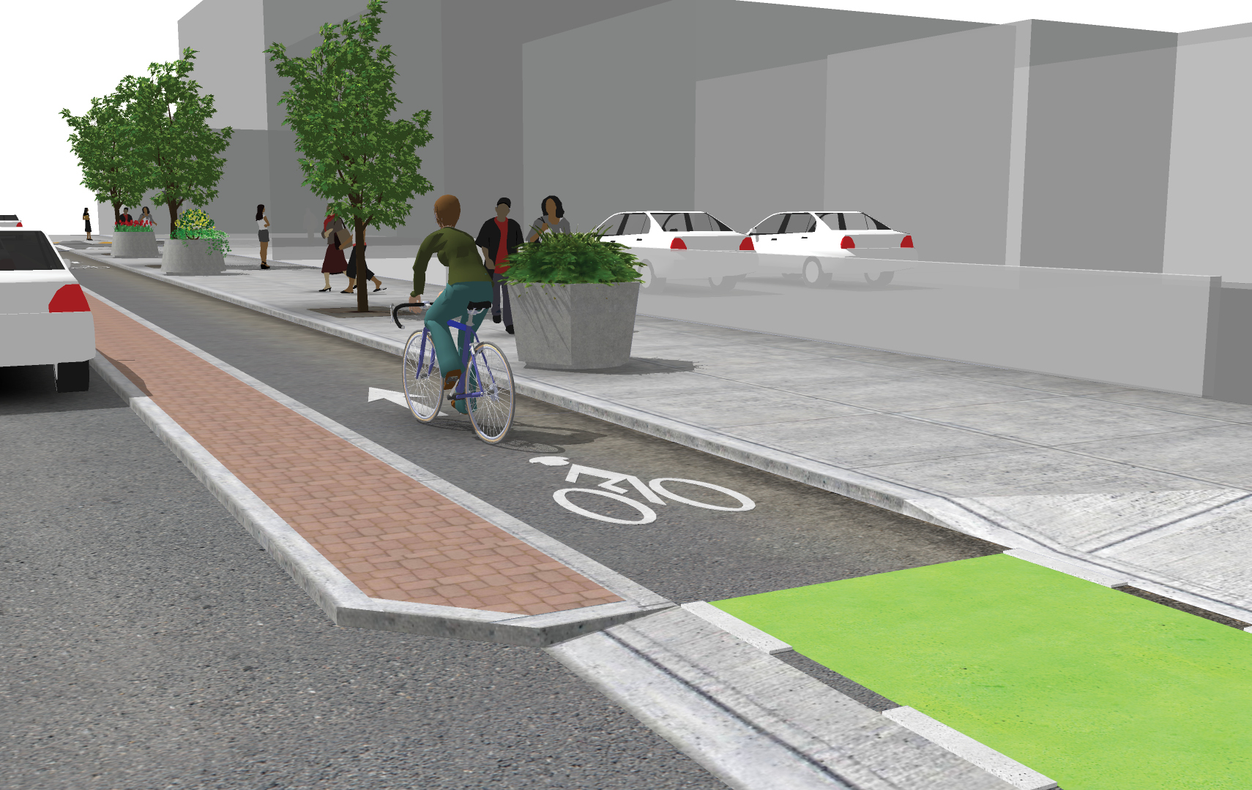
Example - Class IV One-Way Cycle Track Option Full separation between cars and bikes (on-street)

Slide 13

Thank You for Attending! ☺
Questions?
Visit: www.vta.org/280wolfe
Email: community.outreach@vta.org
Call: 408-321-7575
I-280 / Wolfe Road Interchange
Improvements Project
Cupertino, CA

